Slide 1
Leveraging large language models for comprehensive psychological analysis: insights from four theoretical frameworks
Krzysztof Rybinski
Vistula University
Budapest, 21-22 August 2024

Slide 2
LLMs in psychology
Booming research field, Ke et al. (2024) reviewed over 100 papers published since 2022.
Applications across various branches of psychology, including: cognitive, social, cultural, clinical, and developmental psychology.
GPT-ology - hasty and often unjustified application of LLMs in psychological text analysis (Abbdurahman et al., 2023, 2024).
Many problems identified, specific to psychology and general (e.g. prompt variance)

Slide 3
Motivation
Despite the growing interest in applying LLMs in psychological research, there has been no study comparing the performance of generative AI technology in textual data classification across multiple psychological theories.
This paper aims to fill this gap by addressing several pertinent research questions.

Slide 4
Research questions
Are LLM models effective in extracting psychological profiles from textual data for a broad range of psychological theories, or their performance vary depending on the theory applied?
What are the effective strategies to design LLM prompts for personality extraction tasks from text?
What is the quality of LLM-based psychological analysis (human evaluation and machine evaluation)?
Do LLM-derived psychological traits evolve in response to real life events?
Can the LLM-based psychological analysis system be generated automatically (by generative AI, with minimal human supervision) for any psychological theory?

Slide 5
Data (1)
Dataset of 25,780 emails written by a senior executive with multi-country experience (Person X) between January 2008 and March 2024.
Gmail API used to collect email recipients, date and full email text, including replied-to content.
Regex in Python used to extract only the text authored by Person X
Python code generated by ChatGPT-4, human prompting

Slide 6
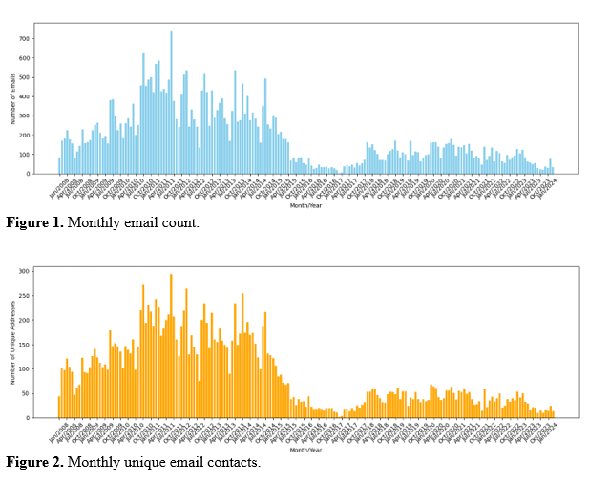
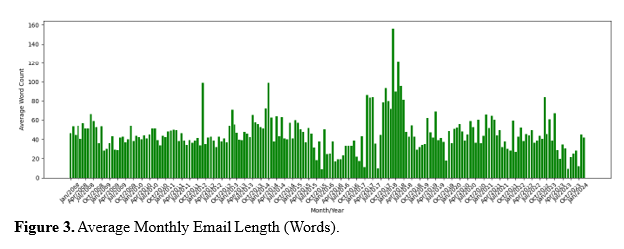
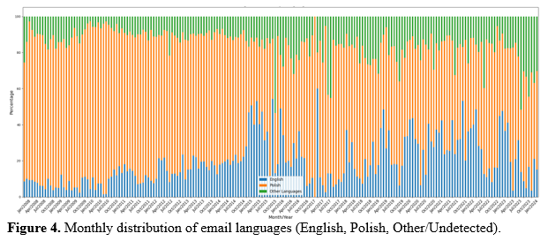
Data (2) Email characteristics summary

Slide 7
Psychological theories selected (ChatGPT) (1)
Self determination theory (SDT): fulfilment of three fundamental psychological needs: Competence, Autonomy, and Relatedness. Classification: Present, Absent, Struggle, None.
In emails, indications of these needs are classified as follows:
Present: The need is clearly reflected, e.g., discussing a successful project indicates Competence is 'Present'.
Absent: No indication of the need, e.g., routine updates with no personal achievements mean Competence is 'Absent'.
Struggle: Difficulty fulfilling the need, e.g., expressing frustration in decision-making indicates Autonomy is 'Struggle'.
None: Insufficient information to assess the need, e.g., brief emails confirming a meeting time.

Slide 8
Psychological theories selected (ChatGPT) (2)
Five Factor Model (Big Five Traits Model): five dimensions: Neuroticism, Extraversion, Openness, Agreeableness and Conscientiousness. Classification: High, Low, None.
Psychological Well-Being Theory (PWB): six distinct dimensions: Autonomy, Environmental Mastery, Personal Growth, Positive Relations with Others, Purpose in Life, and Self-Acceptance. Classification: Enhancing, Struggling, Maintaining, Not Applicable.
Cognitive Behavioral Therapy (CBT): ten negative cognitive distortions: All-or-Nothing Thinking, Overgeneralization, Mental Filter, Disqualifying the Positive, Jumping to Conclusions, Magnification or Minimization, Emotional Reasoning, Should Statements, Labeling and Mislabeling, and Personalization. Classification: Exhibits, Hints at, Does not exhibit.
Classification labels suggested by ChatGPT-4

Slide 9
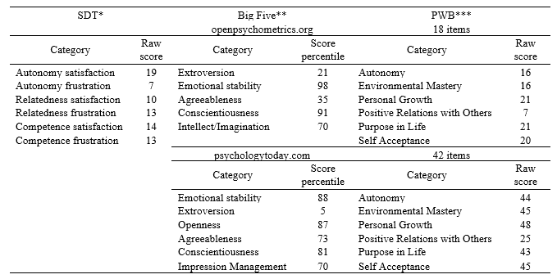
Person X psychological tests results

Slide 10
Methodology (1)
GPT-3.5 Turbo used for inference, GPT-4 used for prompt generation. Temperature set to 0, to enhance reproducibility. Total API cost $185.
The prompts were sent to the GPT-3.5 Turbo API as a system message, while the email texts were sent as user messages.
Automatic prompt design for text rating: zero-shot rater and few-shot rater (eight examples, English-4, Polish-4)
Examples’ format for a few-shot learning approach for SDT
{delimiter}
Text example (EN): I've been struggling to learn the guitar. Despite practicing daily, it just doesn't click.
Proper classification:
{'Competence': 'Struggle', 'Autonomy': 'Present', 'Relatedness': 'None'}
{delimiter}

Slide 11
Methodology (2.1)
Example: prompt generated by GPT-4 for SDT; zero-shot rater:
system_message_zs_rater = """ You are a psychologist specializing in Self-Determination Theory (SDT), focusing on assessing three basic psychological needs: competence, autonomy, and relatedness. Given a piece of text, your task is to analyze it and classify the content based on these needs. Determine whether the text expresses feelings or situations related to achieving or struggling with competence (mastery, success, learning), autonomy (independence, choice, preference), and relatedness (connection, collaboration, gratitude). If you are unable to assess how the text is related to a given need, please return "None" for this entry in the output dictionary.
Provide your analysis in the form of a Python dictionary with keys 'Competence', 'Autonomy', and 'Relatedness', marking each as 'Present' if the need is reflected in the text, 'Absent' if not, 'Struggle' if the text indicates a struggle with fulfilling the need, or 'None' if the relation to the need cannot be assessed.
Return only SDT classification in the Python dictionary format, do not add any other text. """

Slide 12
Methodology (2.2)
Example: prompt generated by GPT-4 for Big Five; few-shot rater:
system_message_fs_rater = f""" You are a psychologist specializing in the Big Five personality traits model, focusing on assessing traits of Openness, Conscientiousness, Extraversion, Agreeableness, and Neuroticism (OCEAN). Given a piece of text, your task is to analyze it and classify the content based on these traits. Assess whether the text exhibits characteristics or situations indicative of high or low levels in each trait. If you are unable to assess how the text relates to a given trait, please return "None" for that entry in the output dictionary.
Provide your analysis in the form of a Python dictionary with keys 'Openness', 'Conscientiousness', 'Extraversion', 'Agreeableness', and 'Neuroticism', marking each as 'High', 'Low', or 'None' based on the text's content.
Below you are provided with several examples of texts followed by proper classification, separated by {delimiter}
{delimiter}
Text example (EN): I love trying new exotic foods at restaurants that offer cuisines from around the world.
Proper classification:
{{'Openness': 'High', 'Conscientiousness': 'None', 'Extraversion': 'None', 'Agreeableness': 'None', 'Neuroticism': 'None'}}
{delimiter}
Text example (PL): Często czuję się przytłoczony przy planowaniu moich dni i zarządzaniu czasem.
Proper classification:
{{'Openness': 'None', 'Conscientiousness': 'Low', 'Extraversion': 'None', 'Agreeableness': 'None', 'Neuroticism': 'High'}}
{delimiter}
[…. Six more examples …]
Return only Big Five classification in the Python dictionary format, do not add any other text."""

Slide 13
Methodology (3)
Measuring model internal consistency for zero-shot and few shot-learning, representative sample of 1000 emails, two runs for each prompt and calculating Cohen’s Kappa. (to check research reproducibility).
Machine evaluation: zero shot rater (model 1), few shot rater (model 2) and few shot evaluator (model 3 – different rated examples in the prompt than in model 2). Model 3 acts as evaluator for model 1 and model 2, we calculate Cohen’s Kappa. (to address prompt variance).
Human evaluation: comparison of LLM-based ratings with a personal profile and psychological test results.
Regression analysis: outcome variable (monthly percentage of emails with a given rating, e.g. for SDT – Competence – Struggle or Competence - Present); independent variables (Person X income index, credit card spending index, dummy for: abroad far, abroad near, death_1_war, death_2, court_case, Big4 partner, AI company, elections, covid_lockdown, number of different email recipients each month, email average length). Monthly data.

Slide 14
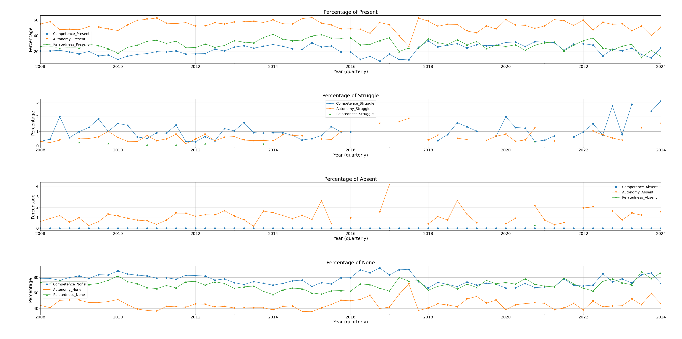
Results (1): SDT (quarterly percentages)

Slide 15
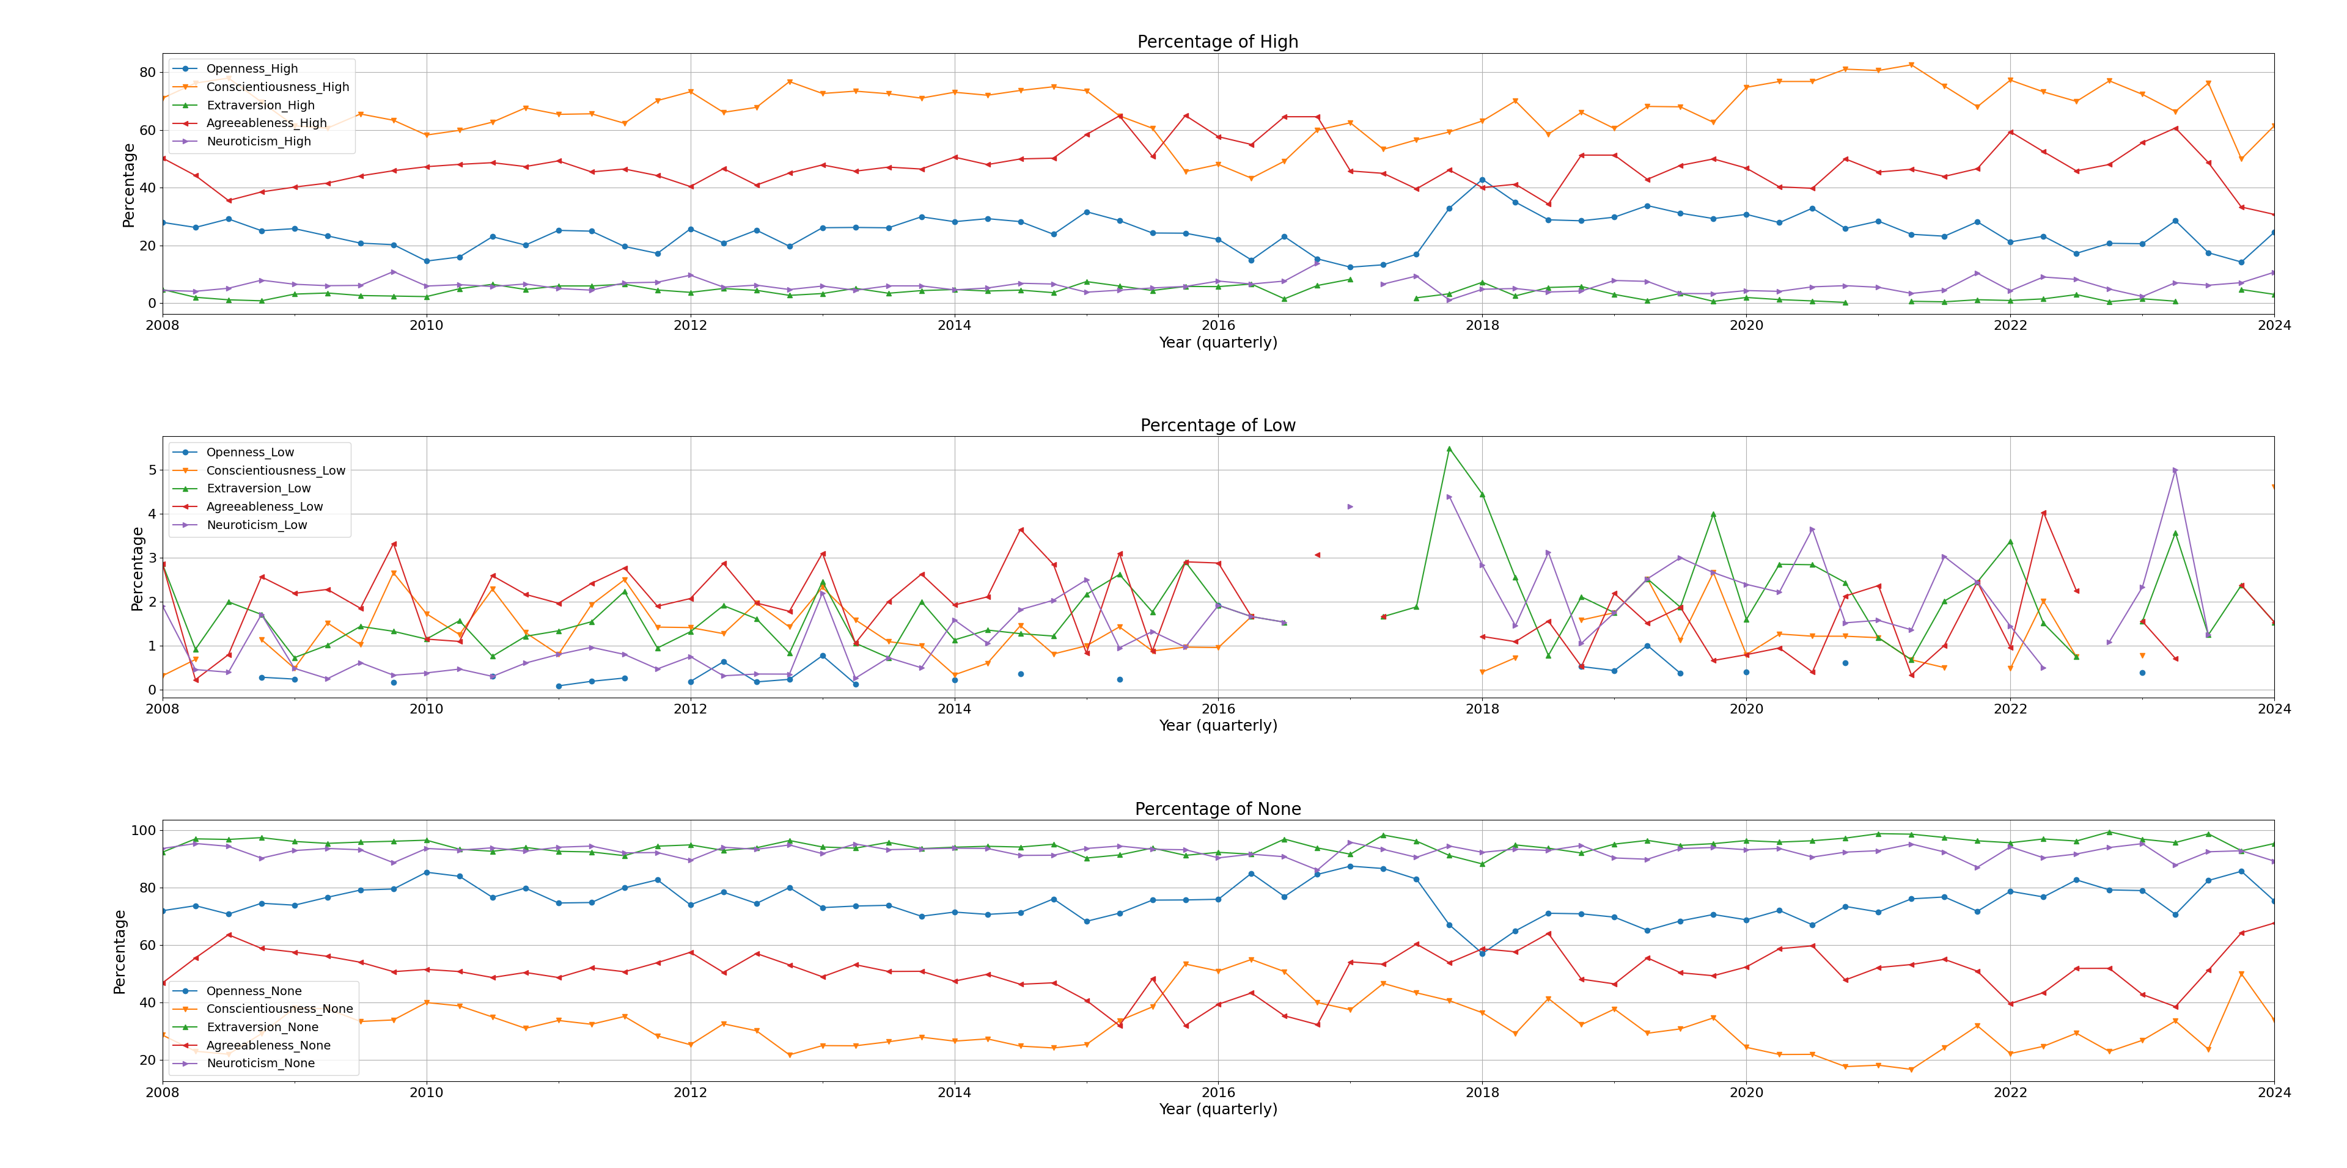
Results (2): Big Five (quarterly percentages)

Slide 16
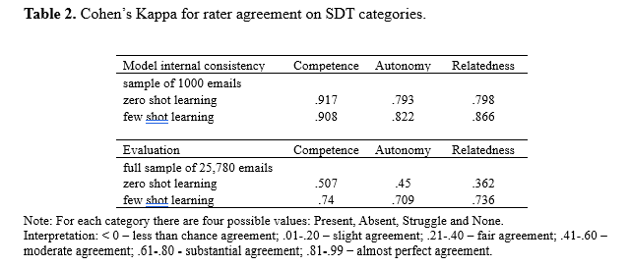
Results (3): Model internal consistency and machine evaluation - SDT

Slide 17
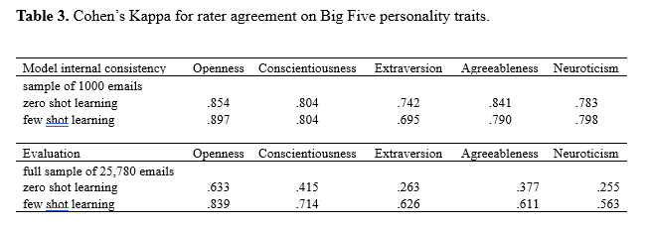
Results (4): Model internal consistency and machine evaluation – Big Five

Slide 18
Results (5) Human evaluation
Machine classification of emails according to SDT closely corresponds to test results reported in Table 1. Autonomy is present in 50-60 per cent of emails while the Person X Autonomy satisfaction test score is 19, with corresponding results for Relatedness (10-20 percent, score 10) and Competence (10-20 percent, score 13). Interestingly prior to 2018 Relatedness was much more present in emails than Competence, then the percentages became similar and both categories exhibit a downward trend. This pattern closely corresponds to relatively high Relatedness frustration score (13) in the test compared to Relatedness satisfaction score (10).
Similar results are observed for the Big Five personality traits theory. The presence of Conscientiousness was detected as high in around 60-80 percent of emails with the test score percentiles at 81 and 91, followed by Agreeableness (40-60 percent and 35th or 73rd percentile) and Openness (20-30 percent and 70th or 87th percentile). The two categories with the lowest presence in emails are Extraversion and Neuroticism scoring high in emails in single percentages and rated as lowest percentiles in the tests (Extraversion with 5th and 21st percentile and Neuroticism (reversed Emotional stability with 12th and 30th percentile).
LLM detected six categories of PWB theory in email texts far less often than for the previous two psychological theories so the comparison with the test results is challenging.

Slide 19
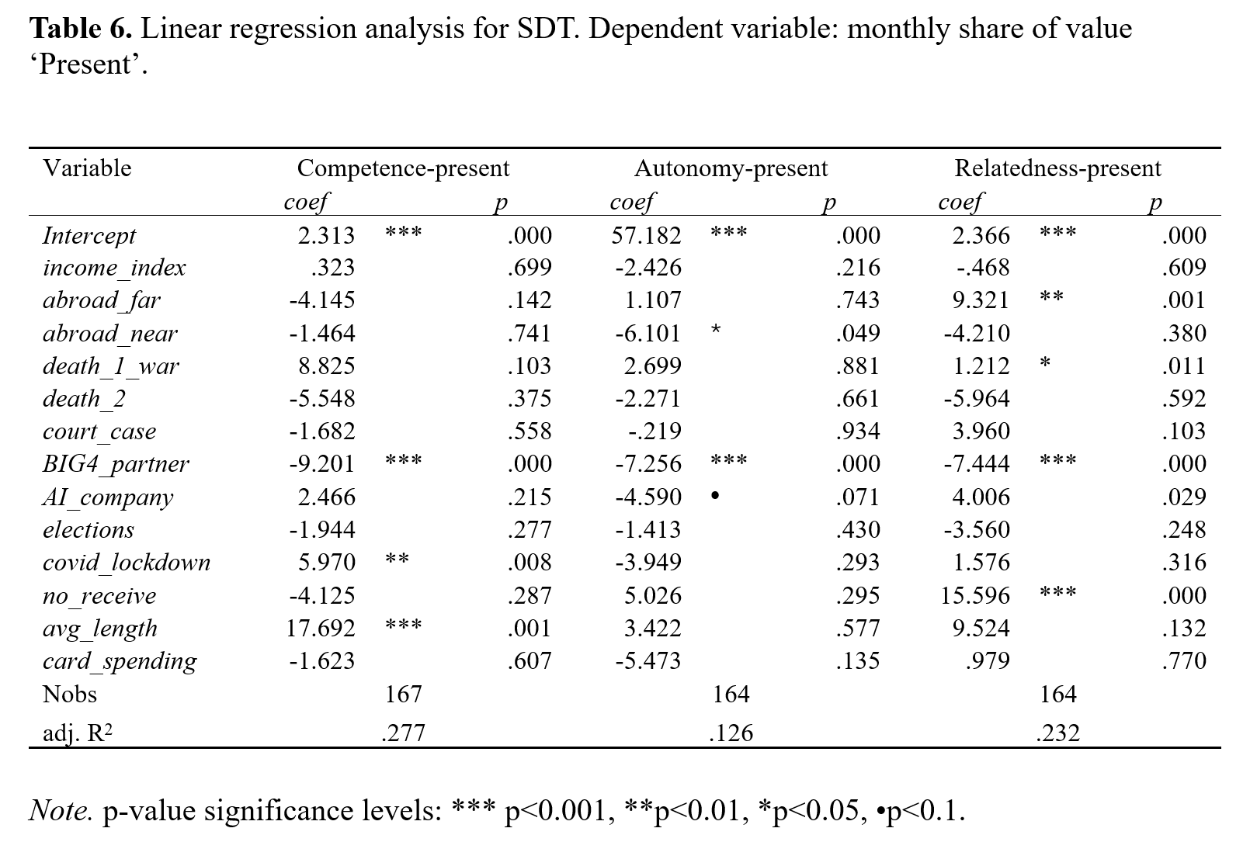
Results (6) Regression analysis, SDT - Present

Slide 20
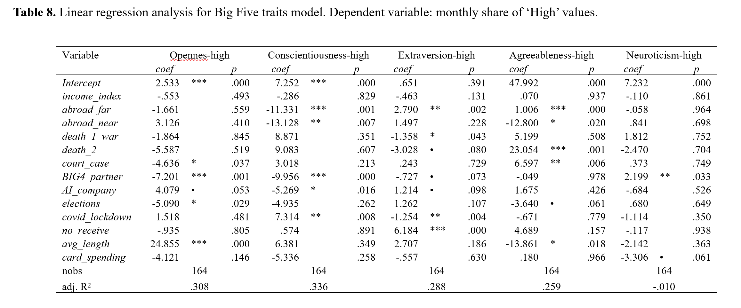
Results (7) Regression analysis, Big Five - High

Slide 21
Results (8) Regression analysis - summary
Regression results consistent with psychological and economic theory.
Example: high income and credit card spending reduced negative behaviors (CBT). Consistent with theory (financial stress leads to negative cognitive distortions, financial security reduces these distortions).
Example: large number of email recipients linked to periods of high extraversion. Consistent with theory as high extraversion is linked to sociability, energy, and the tendency to maintain relationships and social connections.
Regression results are positively validated by Person X life story (as in examples in previous slides).

Slide 22
Conclusions
The models are internally consistent, producing very similar results when applied multiple times to the same dataset (high Cohen Kappa)
Machine evaluation indicated that the results are reliable, particularly for the few-shot learning prompting technique. The model-evaluator scores exhibit moderate to substantial agreement with the model-rater scores across the majority of categories.
This methodology allows for the inclusion of the time dimension in the analysis. It is possible to track changes in psychological characteristics over time without resorting to longitudinal studies.
Regression models capture the influence of various factors, including personal characteristics, environmental variables, and email features, on the psychological characteristics of the email author
The conducted machine and human validation shows that the results of LLM models are robust with respect to prompt design and are consistent with Person X's personal profile established by psychological tests and described in Person X’s narrative characteristics and email features.
The methodology can be fully automated for (almost) any psychological theory.

