Slide 1
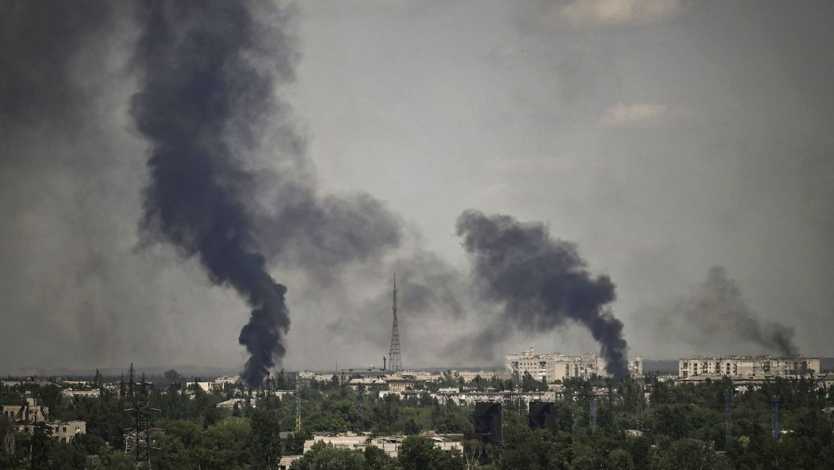
Democracy in Donbas:
Using Text Analysis for Studying Local Policy Adjustments to Hybrid Threats
Margaryta Khvostova
Politics PhD, University of Surrey
​

Slide 2
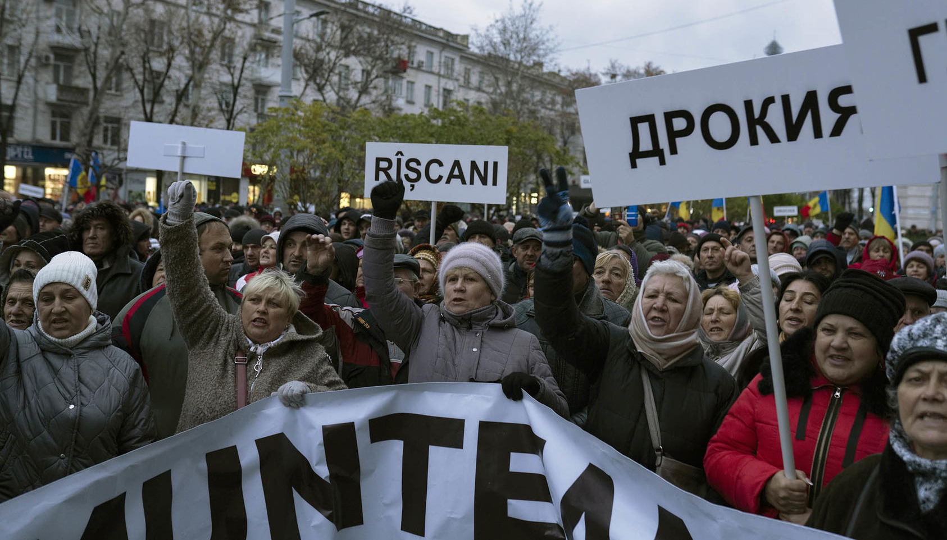
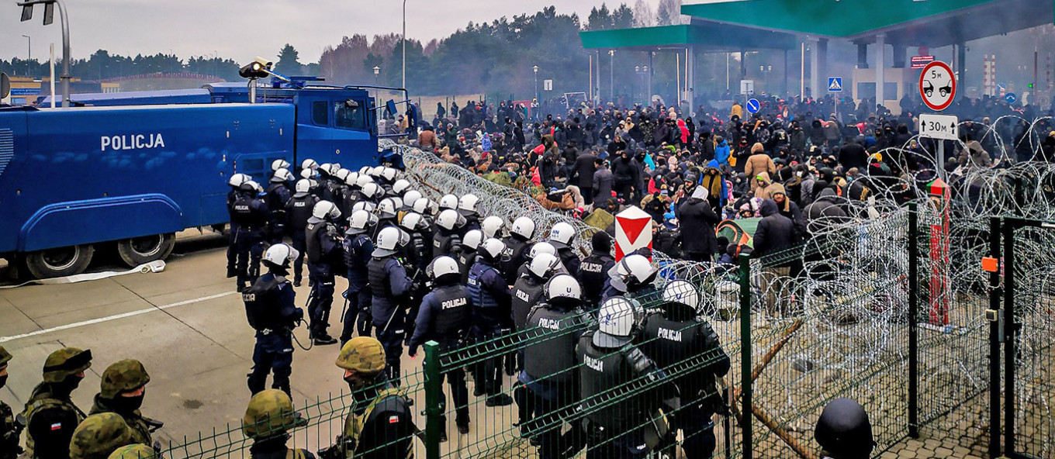
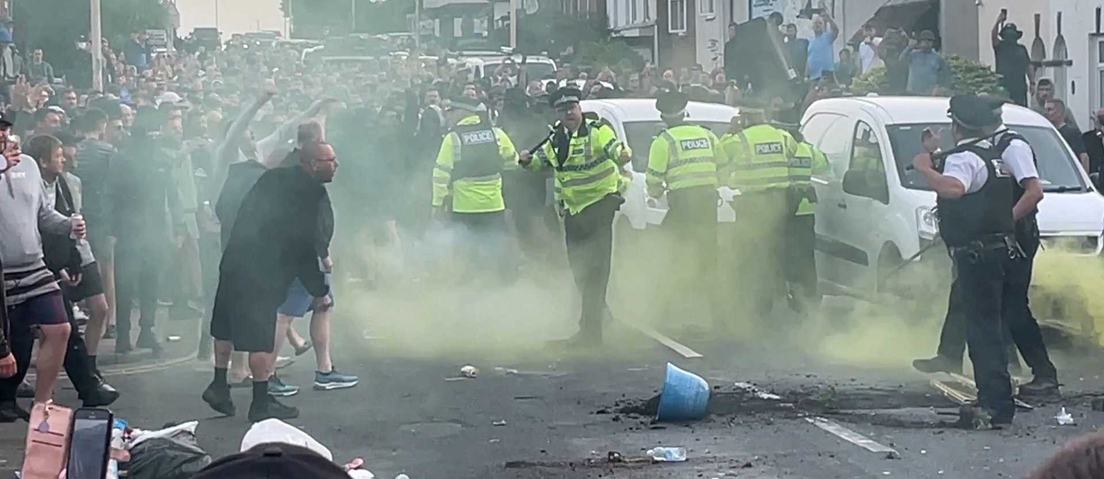
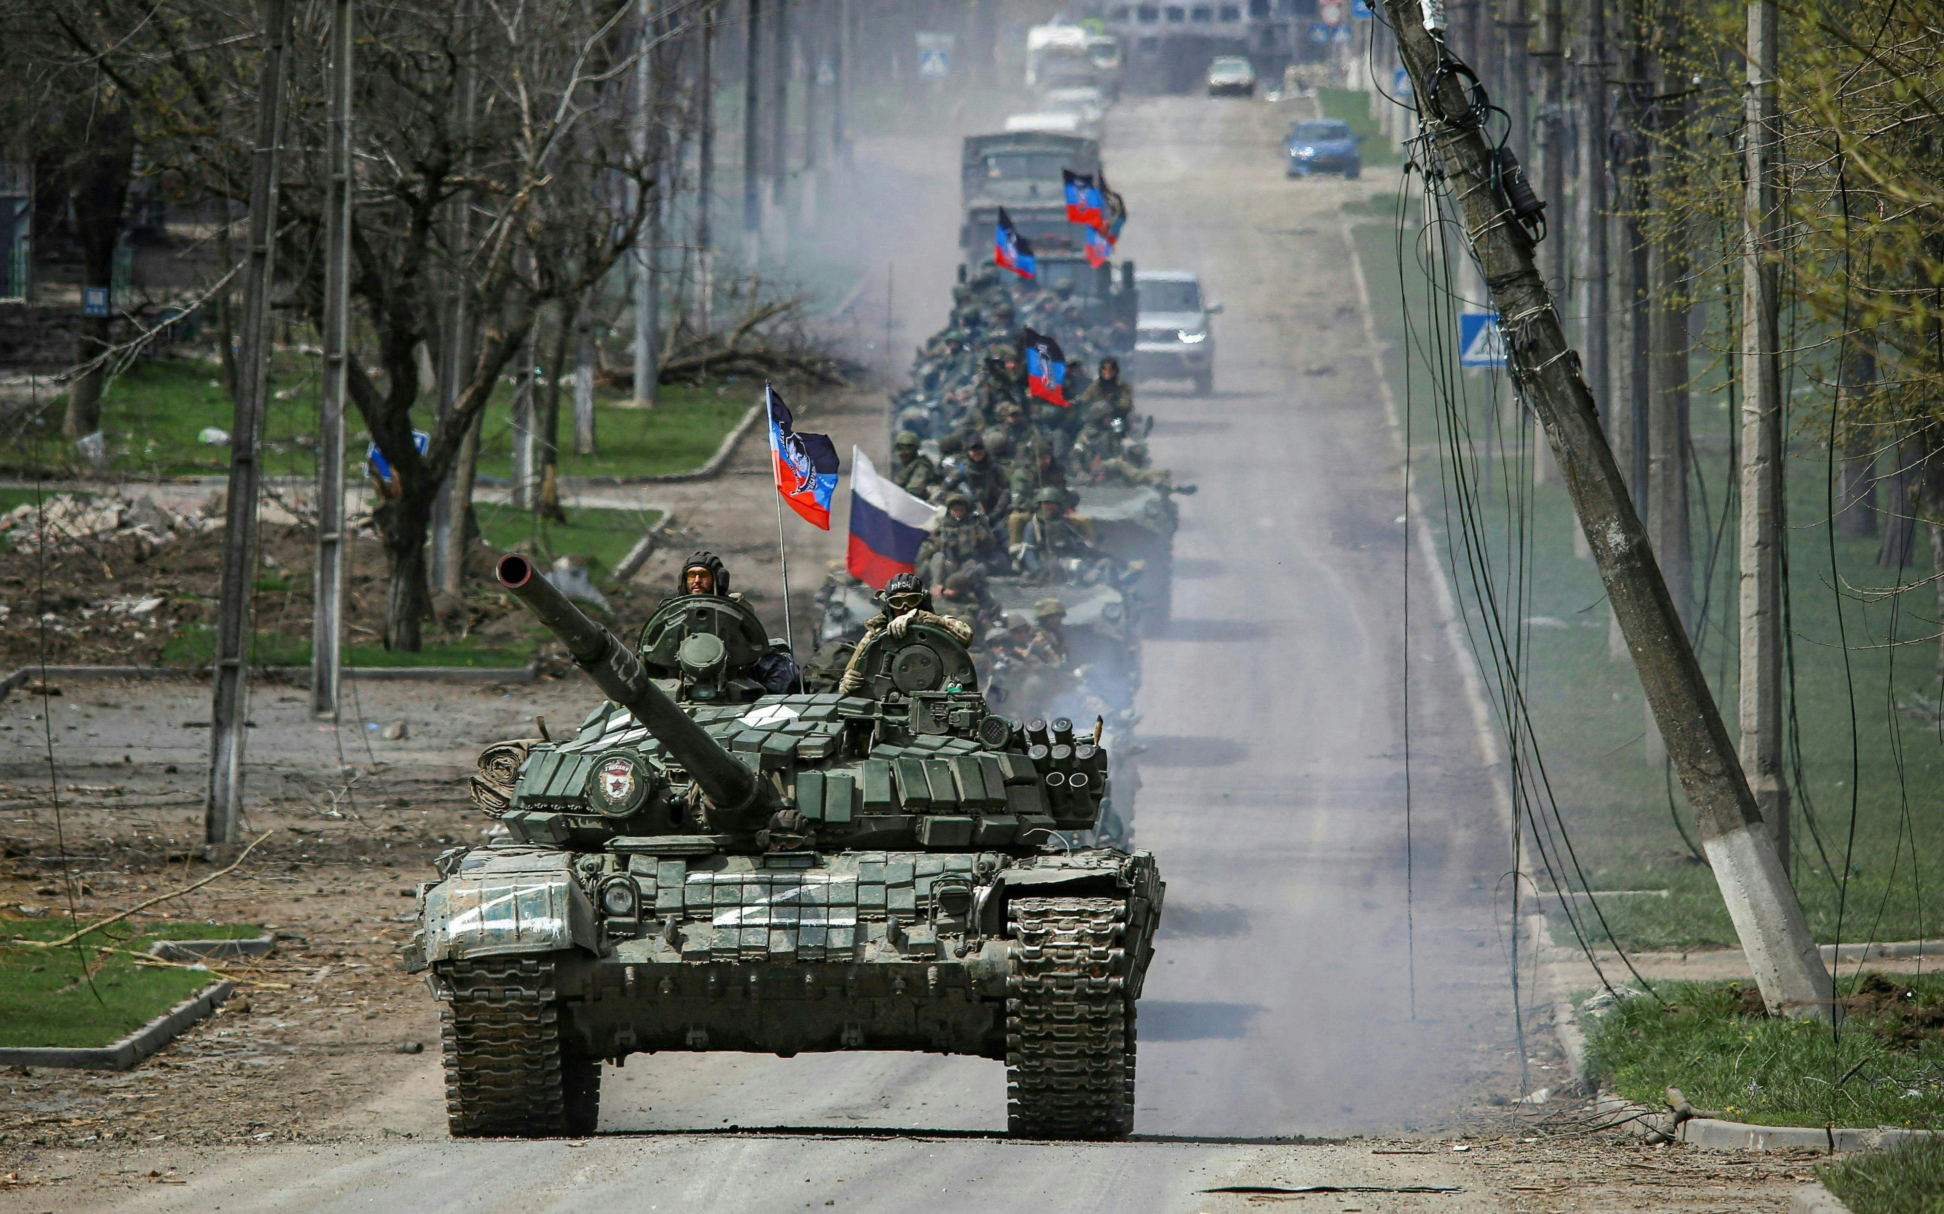

Slide 3
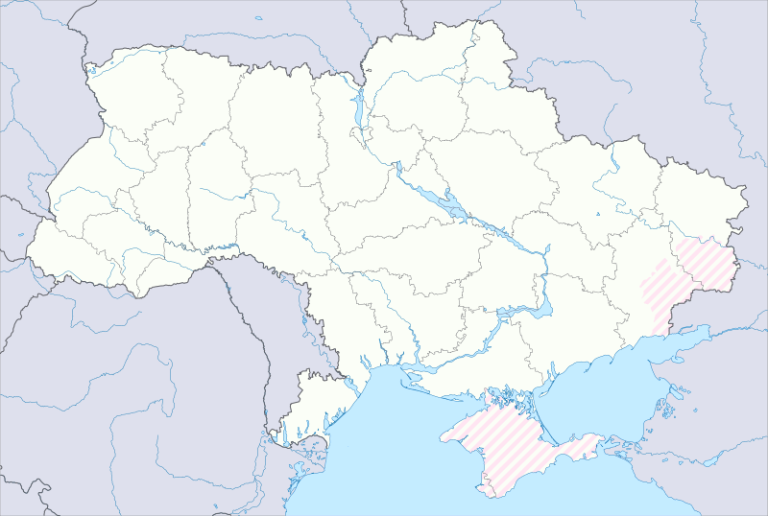
Research Question:
How do democratic institutions develop new practices to build resilience to hybrid threats, especially on a local level?
Lysychansk
Bakhmut
Ukrainian approach:
Addressing the societal divisions and strengthening national identity,
2) Creating the new collaborative security framework,
3) Local resilience and responsiveness to the hybrid threats

Slide 4
Research Design:
1. Longitudinal case study:
Hybrid phase of war: August 2014 – February 2022
Two towns within 30 km of the line of contact: Bakhmut and Lysychansk
Legislative decisions in clusters:
Bakhmut:
  Baseline (City Council): January 2011 – December 2013;
  City Council: September 2014 – February 2022.
Lysychansk:
  Baseline (City Council): January 2011 – December 2013;
  City Council: September 2014 – February 2020;
  CMA: August 2020 – December 2021.
2. Methods:
Topic modelling (LDA) & word embeddings (word2vec)
3. Data collection:
7 171 decisions: 3 438 for Bakhmut and 3 733 decisions for Lysychansk
Lysychansk
Bakhmut

Slide 5
Bakhmut city council 2011-2013
Topic No. | Top-rated terms
1 | taxes, accounting, buildings, residential, economic, ID code, land management, construction, land, public
2 | deputies, protection, municipality, city, social, labour, local, council, commission known, election
3 | economic, social, tax, policy, salary, local, development, minimal, size
4 | communal, municipal, territorial, land, local, privatization, finance, economic, area, municipality, investment, land management, plots
5 | funds, buildings, expenses, stations, budgetary, target, amount, non-residential, pump, temporary, transfers, financial, investment
6 | self-government, education, culture, local, sport, social, permanent, right, children, urban, district, youth, legality, employment
7 | residential, company, housing, managing, residential, co-owners, house, communal, municipality, transfers, enterprises
8 | territorial, communal, state, property, enterprises, municipal, responsibility, limited, transfers, investment, company, finance
9 | communal, territorial, property, municipal, privatization, balance sheet, enterprise, rent, company, land, managing
10 | land plots, cadastre, land, territorial, communal, entrepreneur, request, rent, plots, company, rent, term, limited, responsibility, ID code
11 | health, hospitals, municipal, centre, medical, help, enterprises, protection, finance, control, investment, primary [healthcare], municipality, local
12 | economy, local, project, residential and communal, control, policy, finance, investment, transport, maintenance, ecology, municipality, landscaping

Slide 6
Lysychansk city council 2011-2013
Topic No. | Top-rated terms
1 | rent, land, plot, buildings, maintenance, cadastre, ha [hectare], address, landscaping, area, management
2 | social, protection, culture, labour, veterans, youth, public, children, assistance, sport, family, status, job centre
3 | construction, control policy, water utility, industry, funds, infrastructure, participation, municipality financial, hcs [housing and communal services], water, repair, engineering and transport, environmental protection
4 | house, residential, communal, economy, territorial, property, enterprises, policy, municipality, local
5 | economy, residential and communal, animals, rights, enterprises, maintenance, municipality, landscaping, employees, economic, protection
6 | trade, market, administrative, competition, services, self-organization, rules, goods, management, conditions, sales, collection, information, receiving
7 | land management, area, ha [hectare], land, address, construction, plots, permission, buildings, surrounding, rent
8 | right, plot, land, ha [hectare], area, address, state land committee, permanent, architecture, environment
9 | appeal, deputies, glass factory, enterprises, proletarian, production, accepted, interests, ministries, constitution, gas, city, rights, production
10 | fund, application, expenses, budgetary, municipality, finance, budgetary, special, planning, local
11 | education, service, health, military, culture, conscription, children, draft, sport, youth, medical, financing, service, institutions, teaching, pre-schoolers, students
12 | local, municipality, exploitation, internal, dangerous, waste, site, public, permission, communication, legal, law and order, entrepreneurship, interests

Slide 7
Sum of Estimated Document-Topic Proportions

Slide 8
Sum of Estimated Document-Topic Proportions

Slide 9
Sum of Estimated Document-Topic Proportions

Slide 10
BAKHMUT
 | Culture | Education | Youth | Security
City Council 2011-2013 | education (0.860), sports (0.857), stadium (0.762), recreational (0.754), physical (0.751), youth (0.741), park (0.72), economics (0.687), nephrology (0.671), therapy (0.671) | culture (0.860) youth (0.768) business (0.764) teacher (0.737) statistics (0.734) sports (0.725) economic (0.701) municipal (0.698) urban (0.695) physical (0.692) entrepreneurship (0.690) | education (0.768) family (0.744) culture (0.741) sports (0.716) renaming (0.713) economic (0.690) entrepreneurship (0.669) housing (0.658) internal (0.658) | protection (0.840) reproductive (0.791) nation (0.787) care (0.774) indicators (0.728) resources (0.723) labour (0.714) reduction (0.710) cultural (0.706) guarantees (0.697) family (0.679)
City Council 2014-2022 | education (0.852), sports (0.822), youth (0.800), leisure (0.796), recreation (0.786), physical (0.772), park (0.771), stadium (0.770), rename (0.698), CHI [municipal healthcare, institution] (0.672), family (0.669) | culture (0.852) youth (0.770) business (0.735) financial (0.715) emergency (0.707) economic (0.703) computer (0.692) sports (0.690) | culture (0.800) family (0.799) education (0.770) economic (0.729) sports (0.726) reform (0.659) | animal (0.747) welfare (0.743) forecasting (0.743) border (0.730) savings (0.717) protect (0.694) nazi (0.691) victims (0.687) totalitarian (0.681) vaccine (0.680) prevention (0.676) police (0.672) motherhood (0.671) tuberculosis (0.669) veterans (0.669) freedoms (0.668)

Slide 11
LYSYCHANSK
 | Culture | Education | Youth | Security
City Council 2011-2013 | sections (0.814) physical (0.805) vulnerable (0.764) recreation (0.753) sports (0.750) aesthetic (0.747) | care (0.734) interaction (0.710) integrated (0.671) teachers (0.668) culture (0.659) | family (0.859) sports (0.792) karate (0.750) veterans (0.716) child (0.706) games (0.701) young (0.697) war (0.668) | dependence (0.798) national (0.778) preventing (0.730) socio (0.724) destruction (0.712) foreign (0.694) affairs (0.679) local (0.674)
City Council 2014-2020 | education (0.872) sports (0.723) health (0.716) youth (0.712) folk (0.680) mobilization (0.668) volunteer (0.657) renaming (0.650) | culture (0.865) educational (0.794) sports (0.744) knowledge (0.732) art (0.727) nutrition (0.716) youth (0.699) | adolescents (0.746) reading (0.744) culture (0.743) sports (0.738) reproductive (0.727) young (0.727) gifted (0.717) | safety (0.807) fighting (0.730) repelling (0.717) ecological (0.694) poverty (0.692) sanitary (0.688) strengths (0.685) monuments (0.680) environment (0.679) forces (0.677) defence (0.677)
CMA 2021 | sports (0.819) youth (0.785) patrol (0.774) economics (0.763) consumer (0.748) mobilization (0.737) market (0.734) adolescents (0.694) police (0.688) patriotic (0.669) | general (0.859) preschool (0.846) secondary (0.819) school (0.739) achievements (0.737) youth (0.728) students (0.724) respect (0.722) patriotic (0.714) | sports (0.887) patriotic (0.875) rehabilitation (0.807) culture (0.806) employment (0.792) entertainment (0.779) spiritual (0.766) recreation (0.746) servicemen (0.727) national (0.705) | extradition (0.816) defendants (0.798) national (0.791) soldier (0.768) commander (0.746) sergeant (0.745) battalion (0.729) sapper (0.723) patrol (0.722) battery (0.710)

Slide 12
Conclusions
Ukrainian model: introduction of the military-civil administrations + decentralisation with a focus on the national identity policies;
The local governance institutions reacted to new national identity policies and security threats: increased focus on cultural, educational, social, youth, health, and security policies, while security-related issues tended to spill over into other policy areas.
MCA in Lysychansk proved to be more responsive to security policies and the policies related to national identity, but the language used in all policy areas became noticeably securitised.

Slide 13
Bakhmut city council 2014-2022
Topic No. | Policy area | Top-rated terms
1 | Infrastructure | territorial, household, construction, enterprises, financing, repair, municipal enterprise, landscaping, maintenance, transport, natural, environment, resources
2 | Land management | ha [hectare], cadastre, information, territorial, land plot, public, communal, construction, buildings, privatization, municipal, land management, economic
3 | Healthcare | health, medical, healthy, children, hospital, primary medical care centre, protection, patients, treatment, medical, [primary] medical care
4 | Cultural heritage | culture, museum, local history, territorial community, sport, cic [communal institution of culture], heritage, local history [museum], atc [amalgamed territorial community, economic, social
5 | Youth | education, youth, department of youth policy and children's affairs, children, territorial community, social, information, employment, culture, family, mass, society
6 | Business | territorial, funds, economic, entrepreneurship, reimbursement, small, medium, rates, animals, energy saving, percentage, support, loans, evaluations, cadastre
7 | Social protection | social, protection, children, labour, care, parental, disability, housing, competition, deprived of, orphans, services, youth, residential
8 | Budget | territorial, fund, local, municipality, funds, economic, finance, investment, economic, budgetary, expenses, UAH, control
9 | Education | education, schools, legal, public, secondary [school], i-iii [secondary school], rural, municipality, administrative, renaming, local
10 | Property | communal, territorial, municipal, property, enterprises, privatization, property, debiting, land, company, enterprise, local, amalgamed [territorial community], investment
11 | Security | territorial, protection, security, civilian, fight against, crime, extraordinary, situations, financing, police, mobilization, territorial community, defence, military, civilian protection, strengthening, prosecutor's office
12 | Topic 12 [procedures] | legislation, enterprises, state, employees, municipality, information, authorities, territorial, executive committee, data, tasks, bodies, competencies, institutions

Slide 14
Lysychansk city council 2014-2020
Topic No. | Policy area | Top-rated terms
1 | Social protection | social, protection, veterans, labour, war, financing, suffered, disasters, chernobyl, local, support, youth, opportunities, disabled people, disability, protection, children, benefits
2 | Security | service, military, draft, social, executive, economic, industry, materials, conscription, accounting, construction
3 | Administrative services | administrative, municipality, executive, state, competencies, institutions, information, asc [administrative services centre], enterprises, services, tasks, documents, right, local, urban
4 | Security & social services | participants, ato [anti-terrorist operation], payment, families, local, education, food, members, anti-terrorist, institutions, fighting, actions, pay, services, culture, children
5 | Municipal management | protection, economy, amount, civilian, industry, residential and communal, financing, resources, repair, security, water, environment, extraordinary, networks, construction, enterprises, heating
6 | Land management | land management, plot, area, address, communal, cadastre, construction, buildings municipality, local, property, public, residential, border, control
7 | Business | regulatory, entrepreneurship, state, small, prevention, city, village, trade, economy, employment, crime, police, management, financing, support, offenses, entrepreneurial, public
8 | Infrastructure | municipal property, economy, residential and communal, local, industry, services, funds, control, funds, maintenance, repayment, houses, tariffs, economic, water utilities, electric transport
9 | Budget | fund, application, tax, budgetary, municipality, expenses, buildings, money, objects, amount, appeal, control, local
10 | Healthcare | enterprises, health, property, employees, primary [healthcare], institutions, medical and sanitary, financing, centre, defined, medical, municipal non-commercial enterprise, treatment
11 | Education & culture | children, education, cultures, youth, sport, educational, family, institutions, child, recreation, social, services, school, students, teaching, parental, institutions
12 | Topic 12 [procedures] | rent, land, areas, right, rules, landscaping, maintenance, ha [hectare], register, buildings, city planning, restrictions, design, cadastre, accounting

Slide 15
Lysychansk military-CIVIL administration 2020-2022
Topic No. | Policy area | Top-rated terms
1 | Healthcare | health, help, medical, financing, hospital, municipal non-commercial enterprise, local, enterprises, treatment, continuation, acquisition, equipment, employees, resources, diseases
2 | Youth | youth, culture, sports, children, social, protection, financing, funds, education, support, disability, sanitation, recreation, families
3 | Security | protection, civilian, mobilization, situations, extraordinary, occurrence, bodies, service, police, law enforcement officers, prevention, control, animals, security, consequences, specialized, extraordinary
4 | Municipal management | economy, residential and communal, municipal enterprise, communal, architecture, public, control, security, accounting, ministries, landscaping, highway, reorganization
5 | Education | education, children, competition, employees, secondary [school], school, child, students, education, preschool, parents, teaching, general education, food, director
6 | Social protection | information, confidential, housing, residential, premises, war, protection, family, compensation, social, right, residence, address, internally [displaced], children, deprived of, parental, rules
7 | Administrative services | services, administrative, information, asc [administrative services centre], receiving, advertising, registration, documents, property, cadastre, permission
8 | Child services | birth, region, child, house, address, certificate, care, department, children, judiciary, apartment, rights, area, registered, parental, record
9 | Security & social service | help, social, protection, specialist, labour, commission, centre, family, members, military, territorial, disability, consent, service, violence, conscripts
10 | Land management | areas, land, control, construction, rent, landscaping, land management, architecture, ha [hectare], maintenance, share capital, military, buildings, plot, restrictions, civil
11 | Budget | enterprises, budgetary, water, property, accounting, pay, water utilities, financial, control, expenses, economy, payment, salary, communal, amount, project, cost
12 | Topic 12 [procedures] | structural, subdivisions, competencies, prevention, manager, tasks, corruption, orders, information, employees, authorities, institutions, duties, municipality, legal, officials, control

